Slide 1
Introduction to Unsupervised learning
CLUSTERING

Slide 2


Supervised learning
Training set:

Slide 3
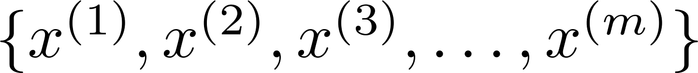
Unsupervised learning
Training set:

Slide 4


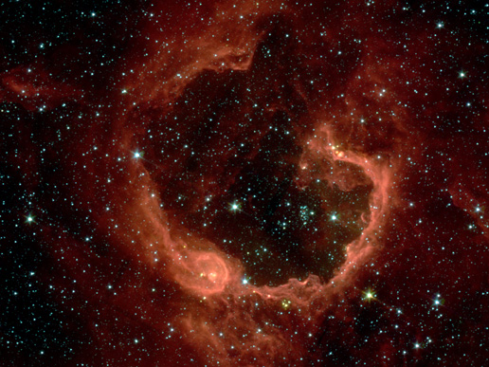
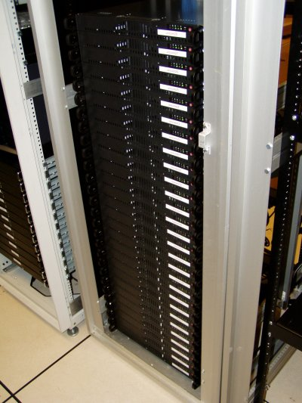
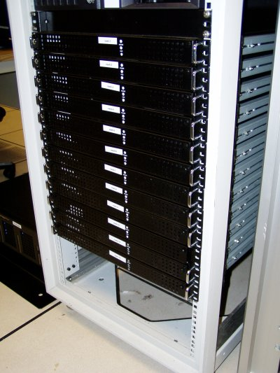
Applications of clustering
Market segmentation
Social network analysis
Image credit: NASA/JPL-Caltech/E. Churchwell (Univ. of Wisconsin, Madison)
Organize computing clusters
Astronomical data analysis
Notes:
Swap: market seg and organize clusters

Slide 5
K-means Algorithm

Slide 6
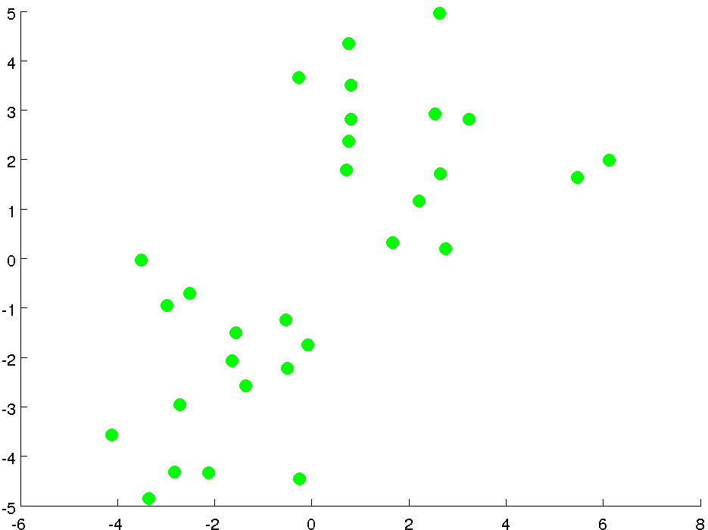

Slide 7
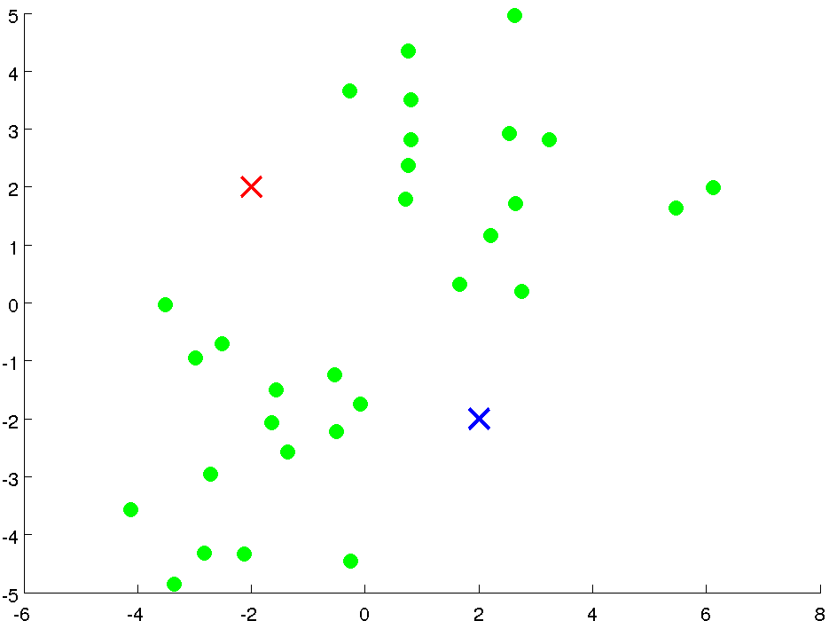

Slide 8
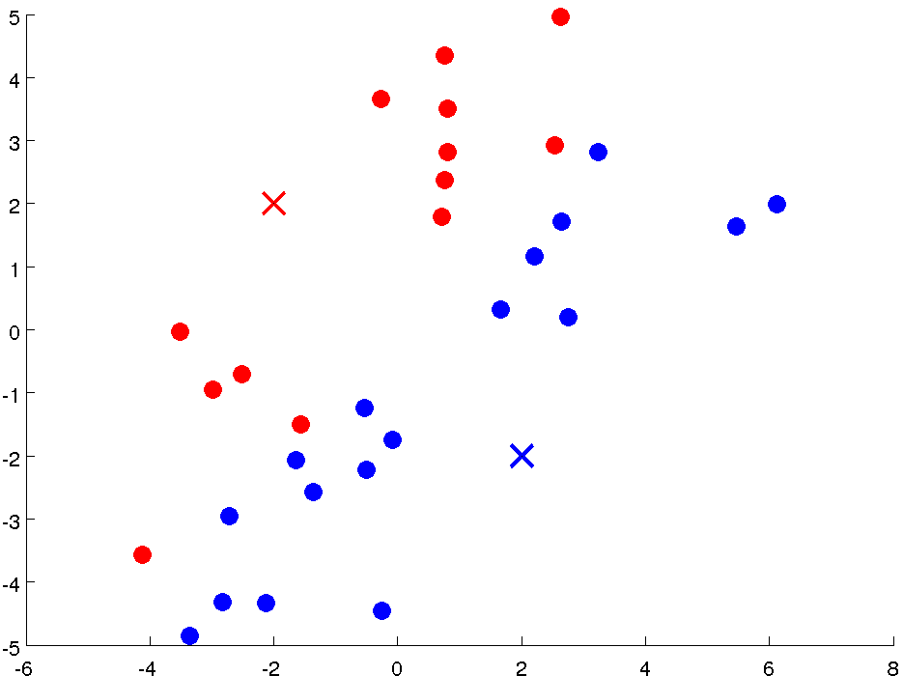

Slide 9
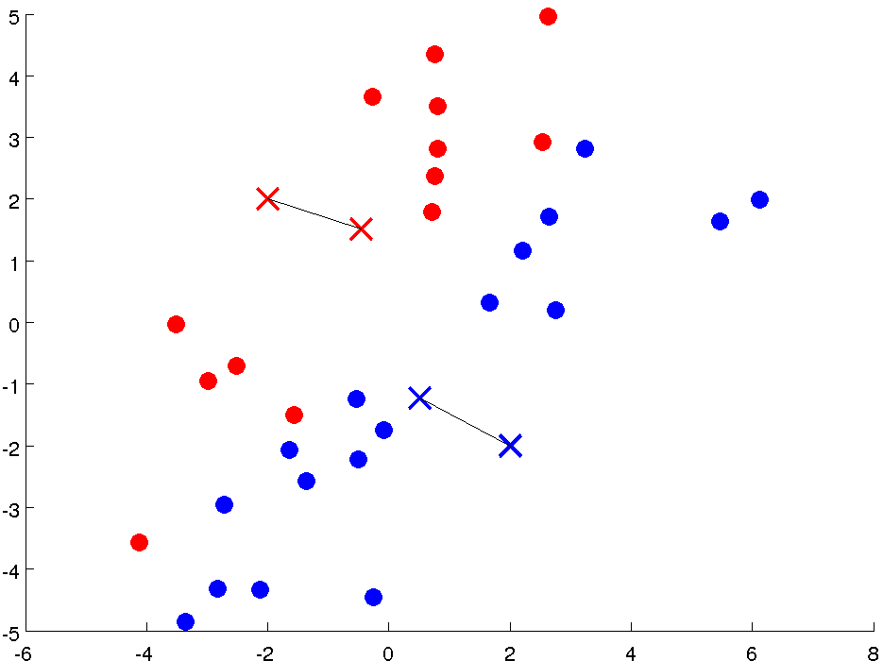

Slide 10
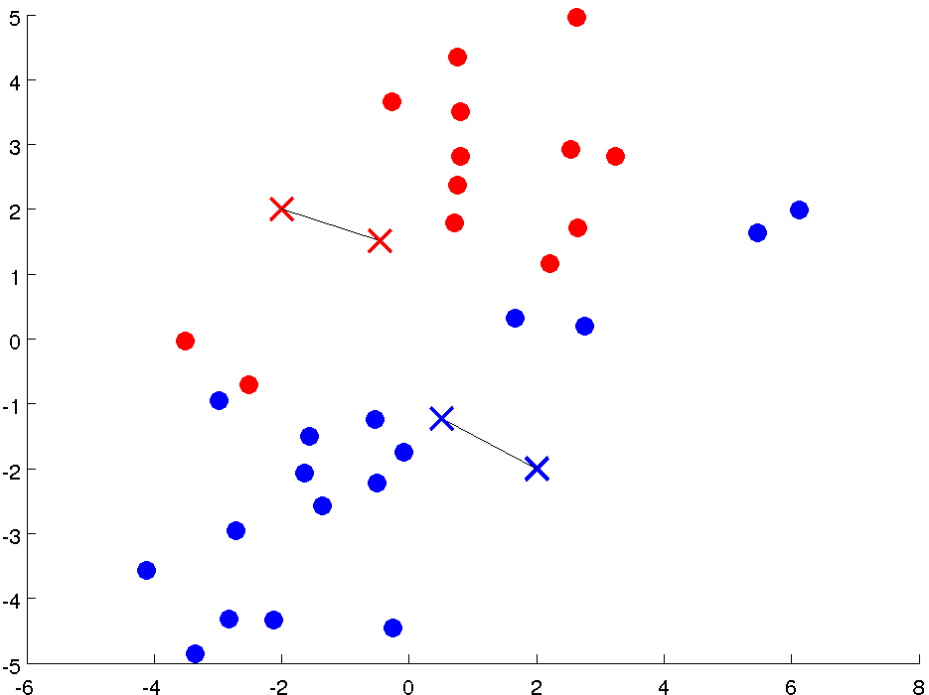

Slide 11
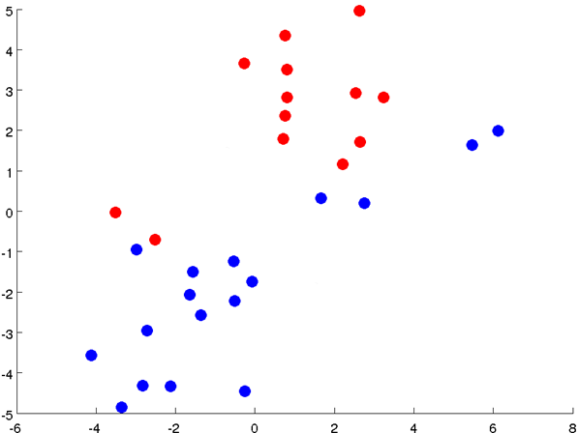

Slide 12
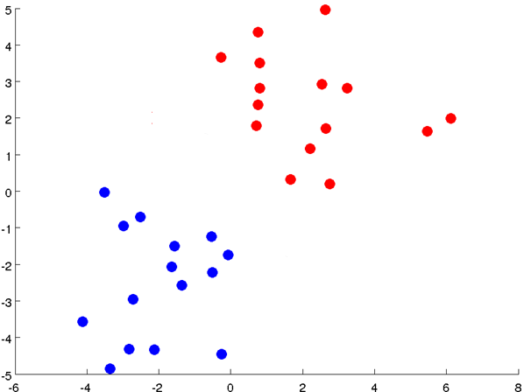

Slide 13
Notes:
Get rid of the legacy points

Slide 14
Notes:
Get rid of the legacy points

Slide 15

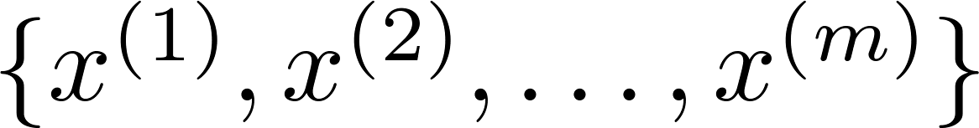
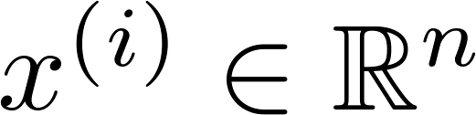

K-means algorithm
Input:
(number of clusters)
Training set
(drop convention)

Slide 16

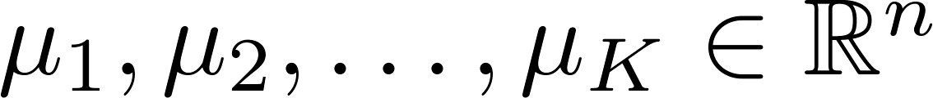



K-means algorithm
Randomly initialize cluster centroids
Repeat {
for = 1 to
:= index (from 1 to ) of cluster centroid
closest to
for = 1 to
:= average (mean) of points assigned to cluster
}
Notes:
Replace with normal text, size with LATEX fonts

Slide 17
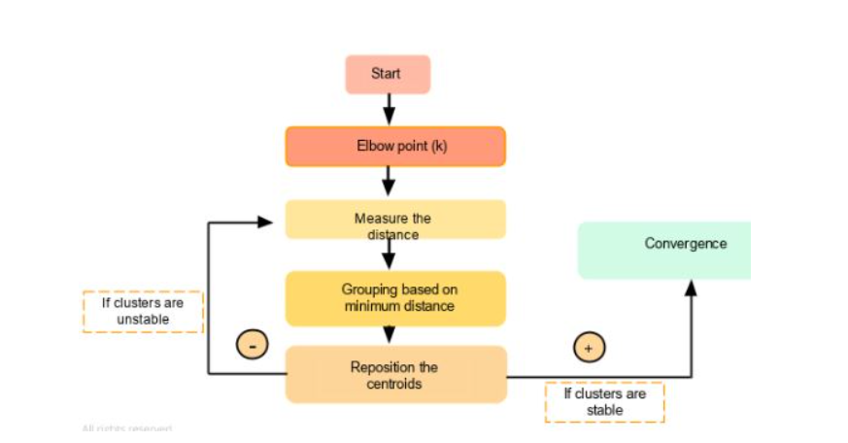
Flowchart of K-means algorithm

Slide 18
K-means for non-separated clusters
T-shirt sizing
Weight
Height

Slide 19
K-MEANS (Optimization Objective)

Slide 20



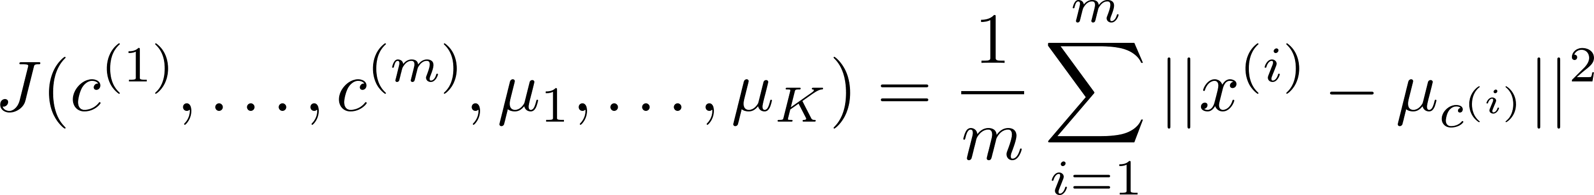
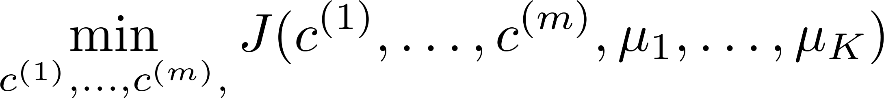

K-means optimization objective
= index of cluster (1,2,…, ) to which example is currently assigned
= cluster centroid ( )
= cluster centroid of cluster to which example has been assigned
Optimization objective:
Notes:
Change numbers to LATEX as well

Slide 21


K-means algorithm
Randomly initialize cluster centroids
Repeat {
for = 1 to
:= index (from 1 to ) of cluster centroid
closest to
for = 1 to
:= average (mean) of points assigned to cluster
}
Notes:
Replace as previous; change spacing to fill page

Slide 22
K-MEANS (Random Initialization)

Slide 23
K-means algorithm
Randomly initialize cluster centroids
Repeat {
for = 1 to
:= index (from 1 to ) of cluster centroid
closest to
for = 1 to
:= average (mean) of points assigned to cluster
}
Notes:
Replace as previous; change spacing to fill page

Slide 24


Random initialization
Should have
Randomly pick training
examples.
Set equal to these
examples.
Notes:
LATEX font

Slide 25
Local optima

Slide 26
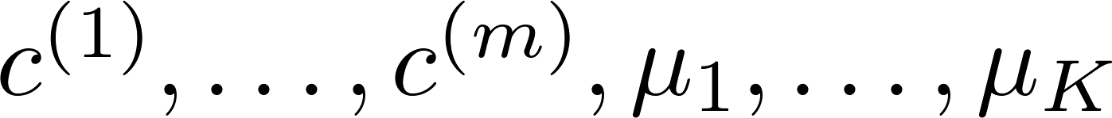
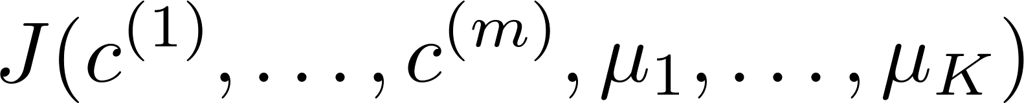
Random initialization
For i = 1 to 100 {
Randomly initialize K-means.
Run K-means. Get .
Compute cost function (distortion)
}
Pick clustering that gave lowest cost

Slide 27
Example of Implementation of k-Means when k=2

Slide 28
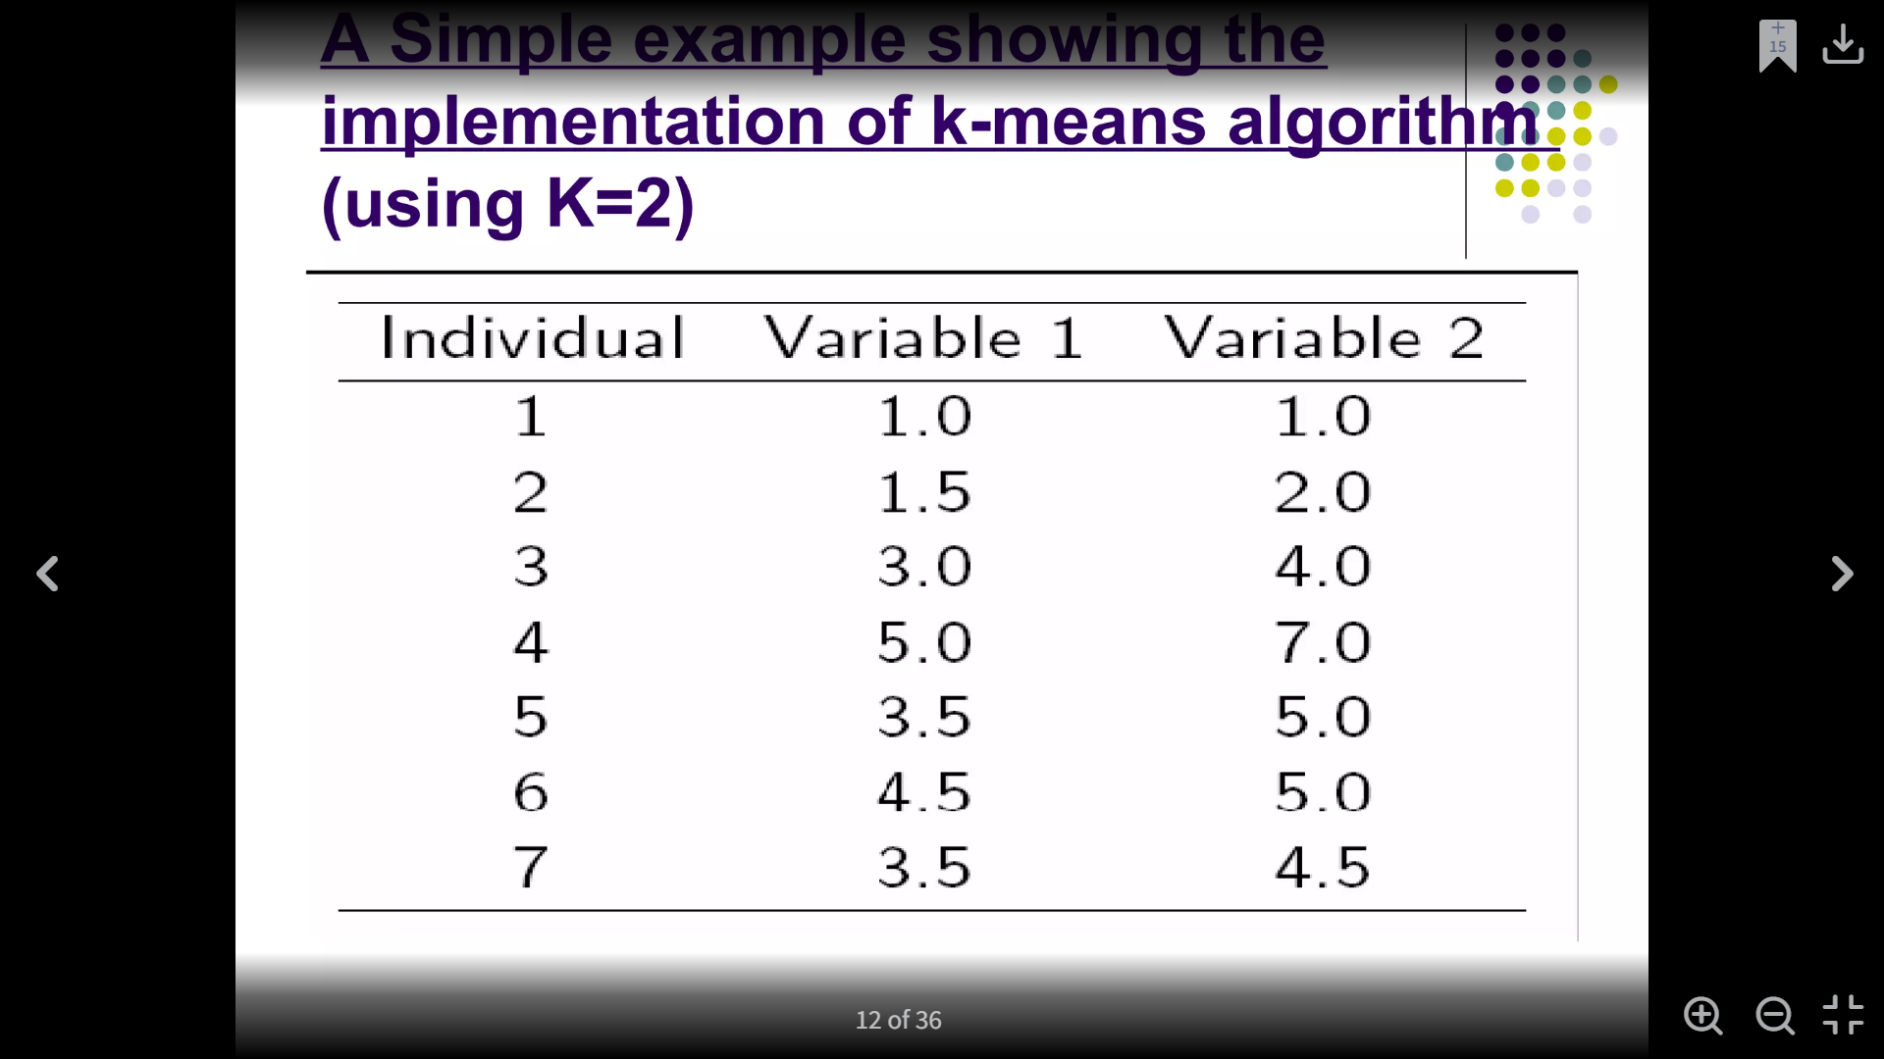
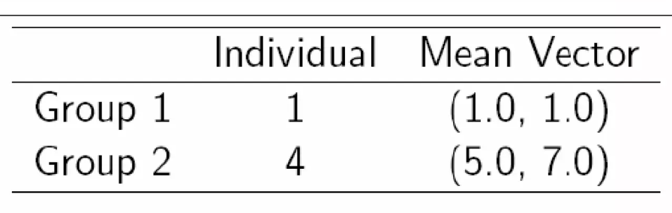
Step 1:
Initialization:
Randomly we choose following two centroids (k=2) for two clusters.
In this case the 2 centroid are: m1=(1.0,1.0) and m2=(5.0,7.0).

Slide 29
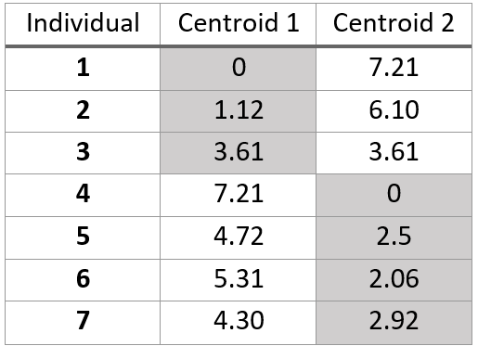
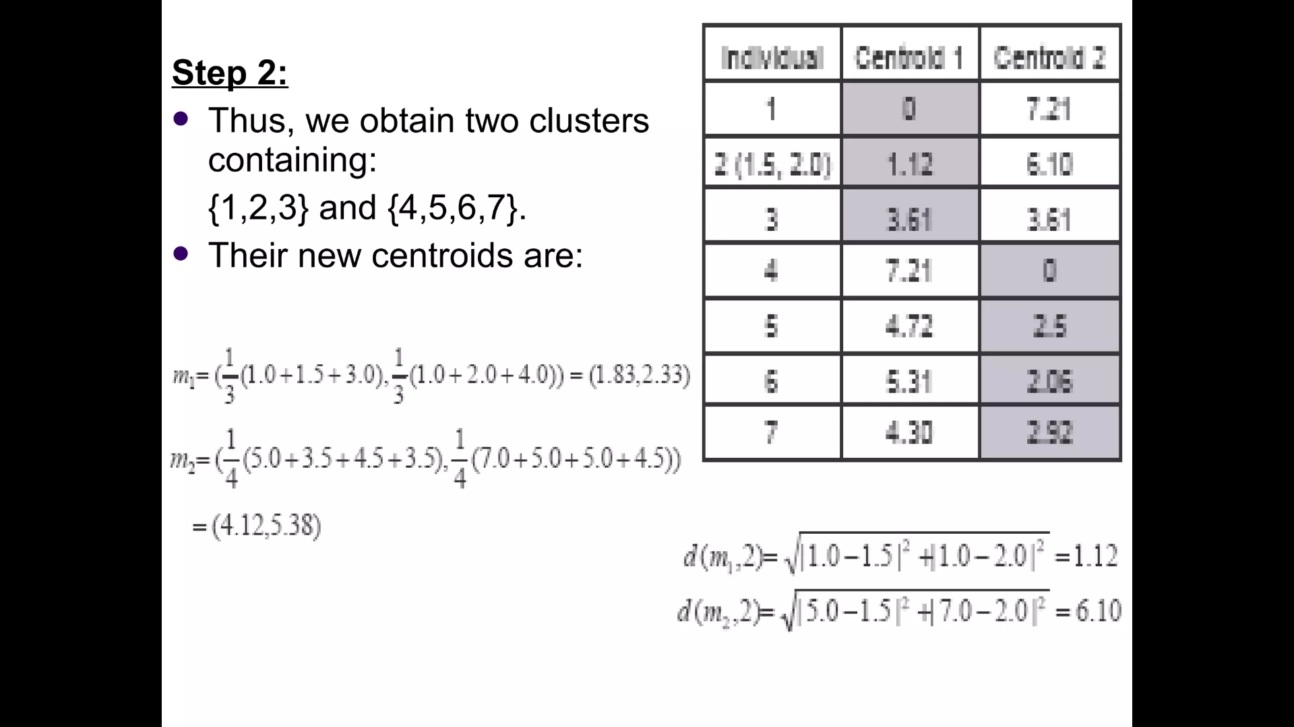
Step 2:
Thus, we obtain two clusters containing: {1,2,3} and {4,5,6,7}.
Their new centroids are:

Slide 30
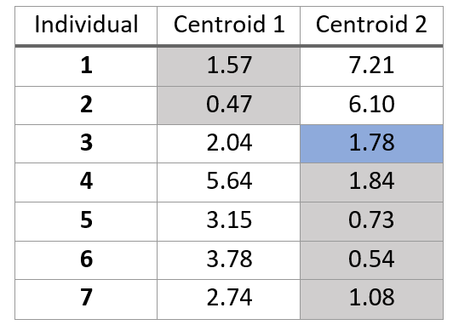
Step 3:
Now using these centroids, we compute the Euclidean distance of each object, as shown in the table.
Therefore, the new clusters are: {1,2} and {3,4,5,6,7}.
Next centroids are: m1=(1.25,1.5) and m2 = (3.9,5.1)

Slide 31
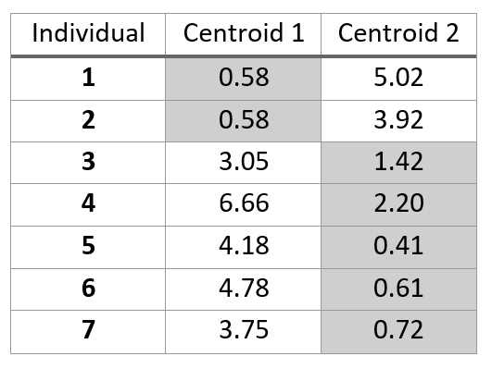
Step 4:
The clusters obtained are: {1,2} and {3,4,5,6,7}.
Therefore, there is no change in the cluster.
Thus, the algorithm comes to a halt here and the final result consists of 2 clusters {1,2} and {3,4,5,6,7}.

Slide 32
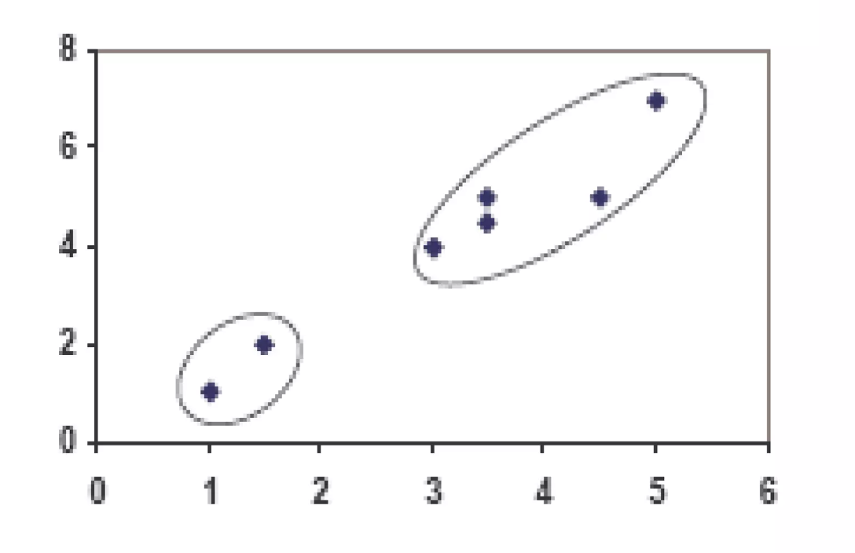
Plot

Slide 33
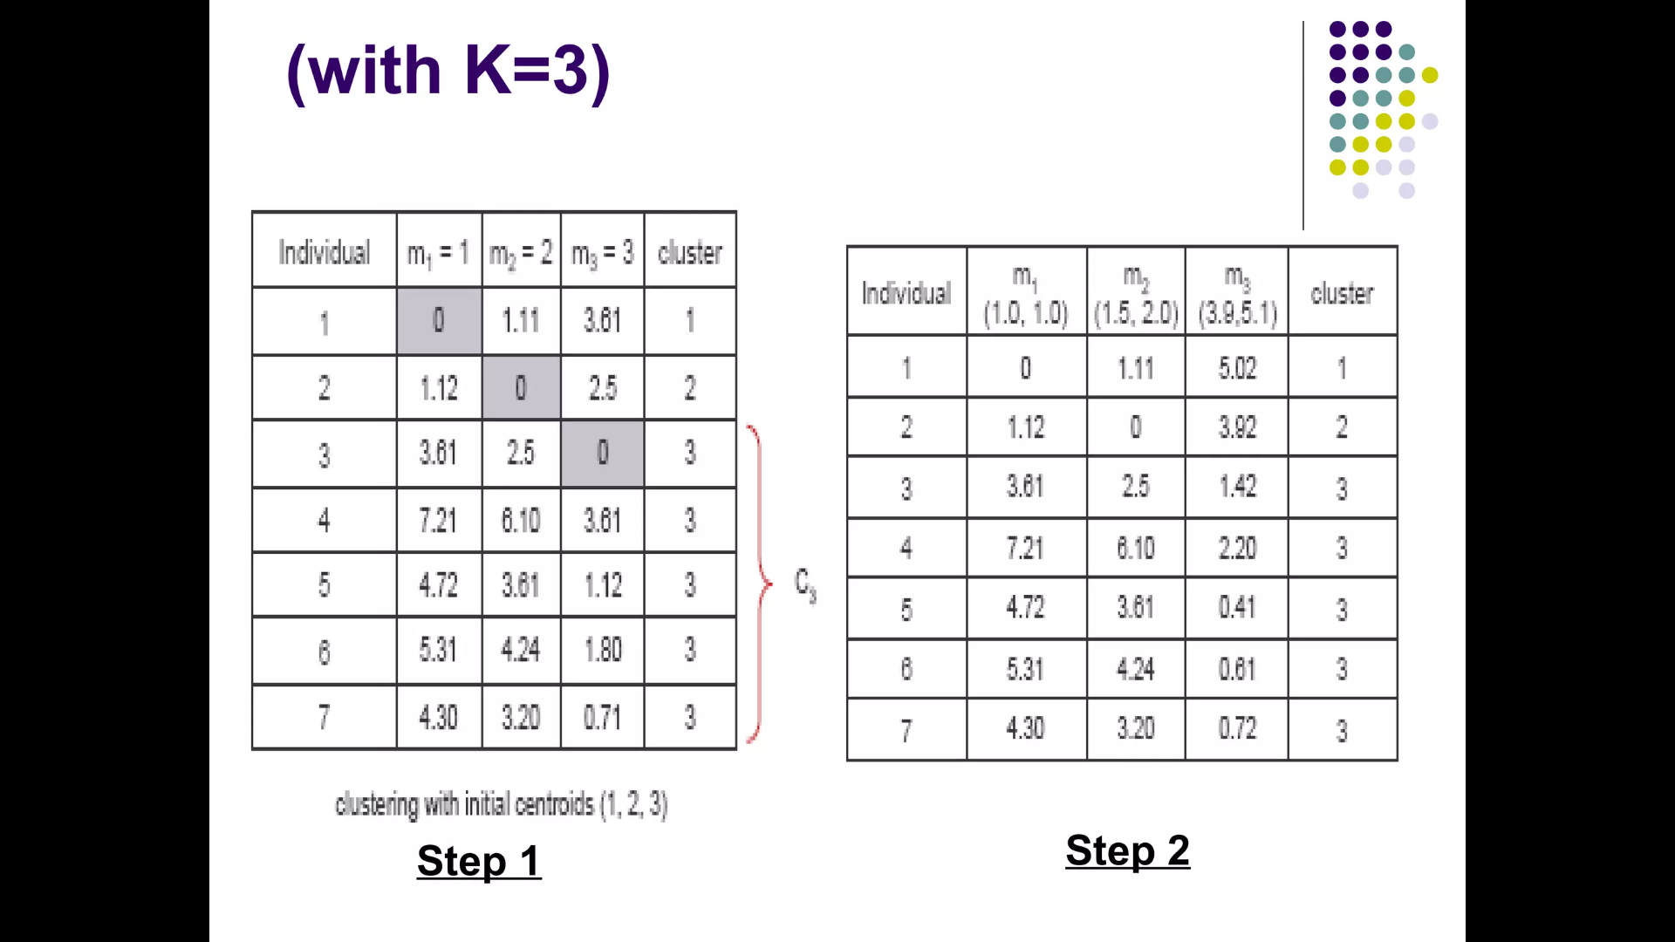
When k=3

Slide 34
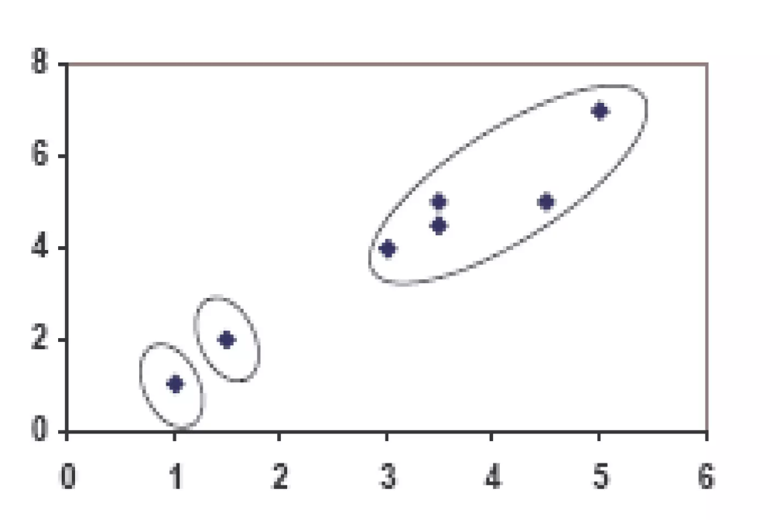
Plot when k=3
For more examples : https://codinginfinite.com/k-means-clustering-explained-with-numerical-example/

Slide 35
Choosing the number of clusters

Slide 36
What is the right value of K?

Slide 37

Choosing the value of K
Elbow method:
Cost function
Cost function
(no. of clusters)
(no. of clusters)

Slide 38
Choosing the value of K
Sometimes, you’re running K-means to get clusters to use for some later/downstream purpose. Evaluate K-means based on a metric for how well it performs for that later purpose.
E.g.
T-shirt sizing
T-shirt sizing
Weight
Weight
Height
Height

